Slide 1



AI Fusion
DRONE DELIVERY SYSTEM
FOR MEDICAL SUPPLIES
AidDrone
Team: NOVELLUS

Slide 2
Table Of Content
About Our Project
Functionality
01
04
About AID-DRONE, A Drone Delivery System Which Delivers Medical Supplies
The Functionality used in the project
Technology Used
Project Stages & Goals
02
05
The Technology Used in Our Project
How and where can this application be used for medical military services
Process
Future Scope
03
06
The Process That will be followed in the process
The Future Scope of the project

Slide 3

About Our Project
The project aims to develop a drone-based delivery system to provide medical services and food supplies to abandoned regions. Equipped with advanced sensors and AI algorithms, the drones will identify abandoned areas and deliver essential supplies autonomously. The system includes geospatial mapping, secure packaging, real-time communication, and regulatory compliance. Community engagement and continuous improvement are central to the project's success, ensuring effective delivery and positive impact on vulnerable populations.

Slide 4
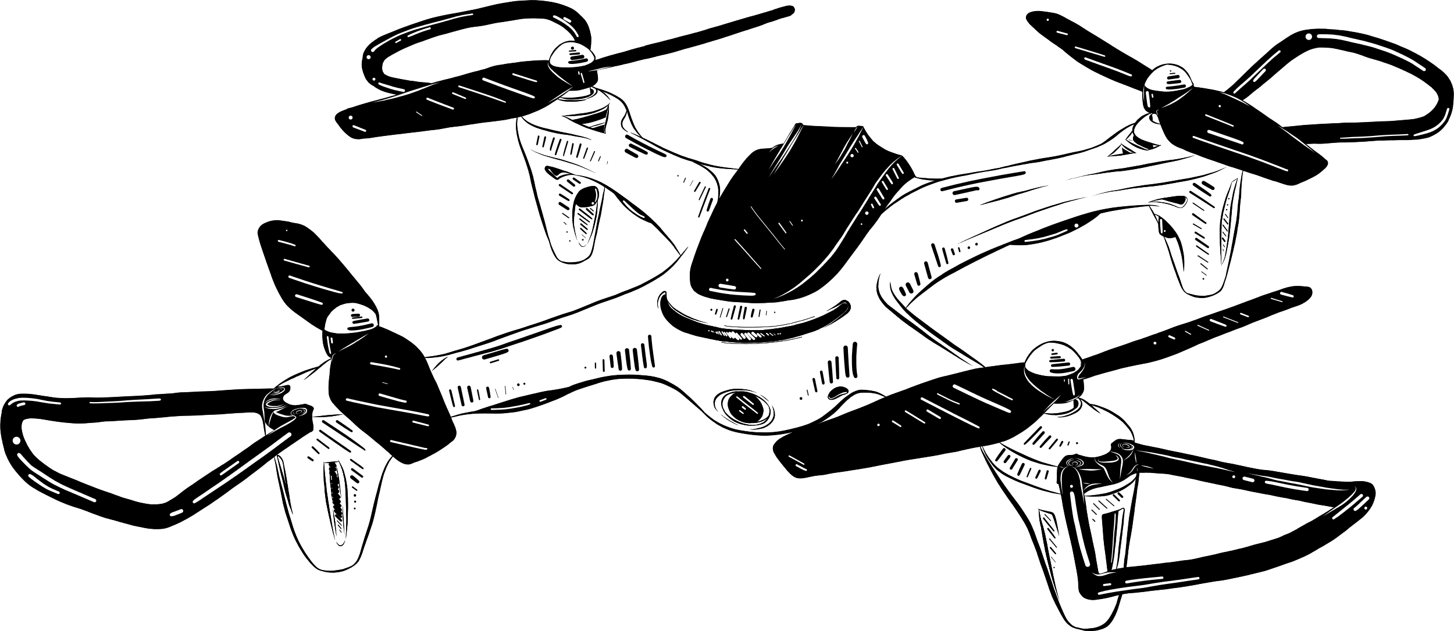
Technology Used
Website
NextJs and TailWind
Machine Learning Model
Tensorflow
OpenCV2
Pandas
NumPy
Matplotlib
API: Flask

Slide 5

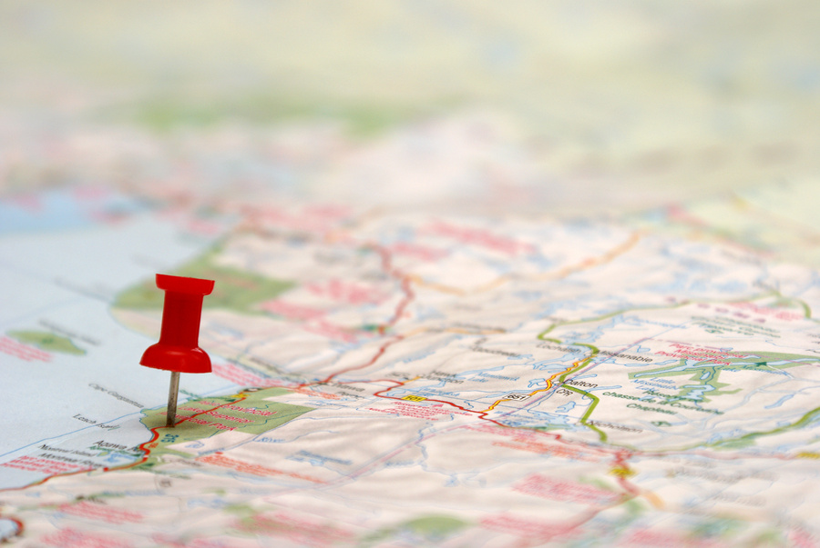
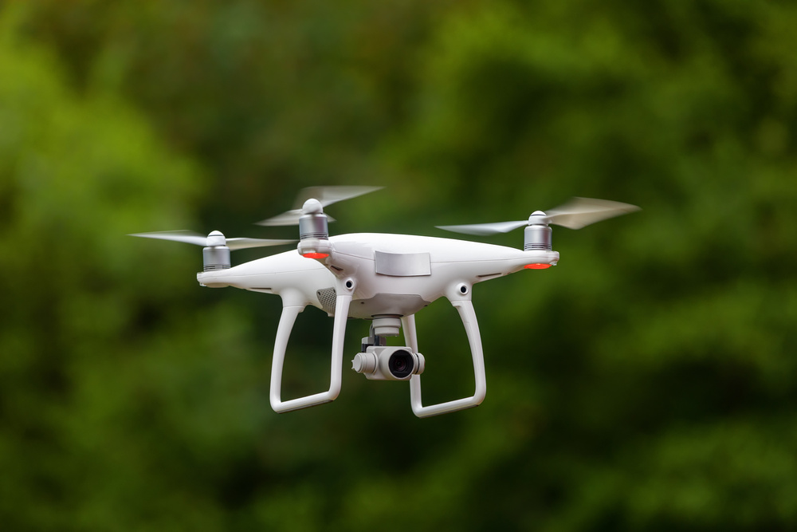
Process
The Process that is followed by out project procedure
Obstacle detection and avoidance
Precision Landing
Predictive Maintenance
Obstacle detection and avoidance involve equipping drones with sensors such as LiDAR (Light Detection and Ranging) or cameras to detect obstacles in their flight path.
Precision landing involves the ability of drones to land accurately at predetermined locations.
Predictive maintenance utilizes data analytics and sensor technology to anticipate potential issues and schedule maintenance proactively.

Slide 6
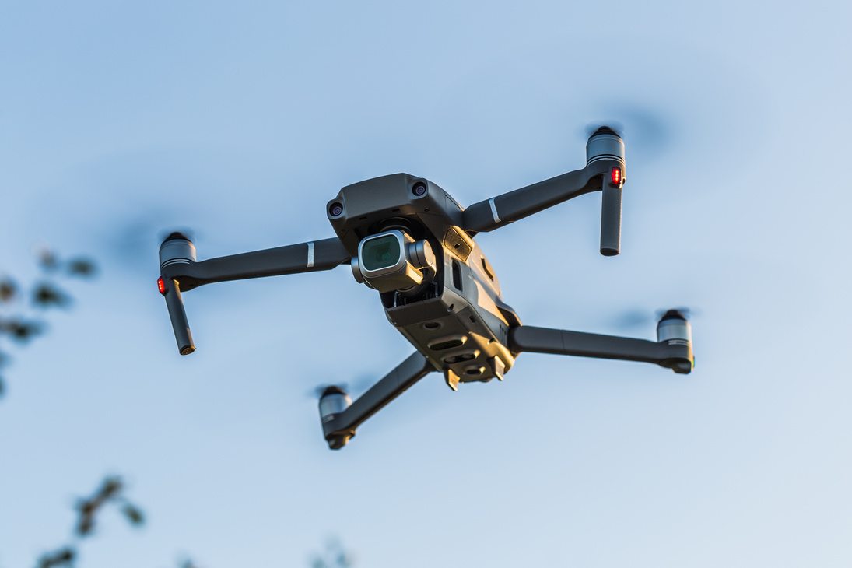
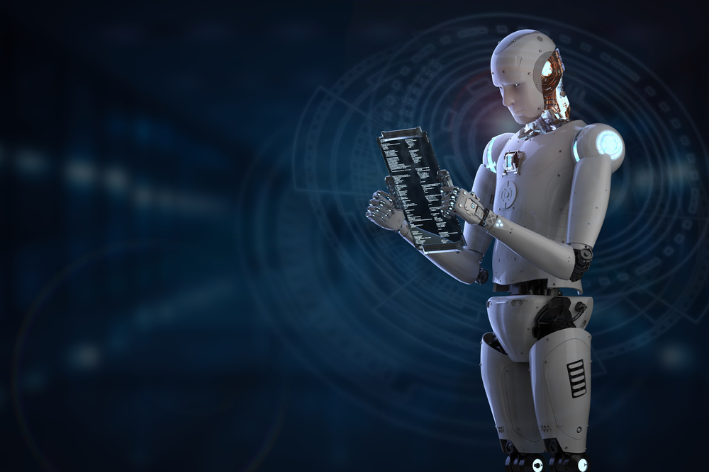
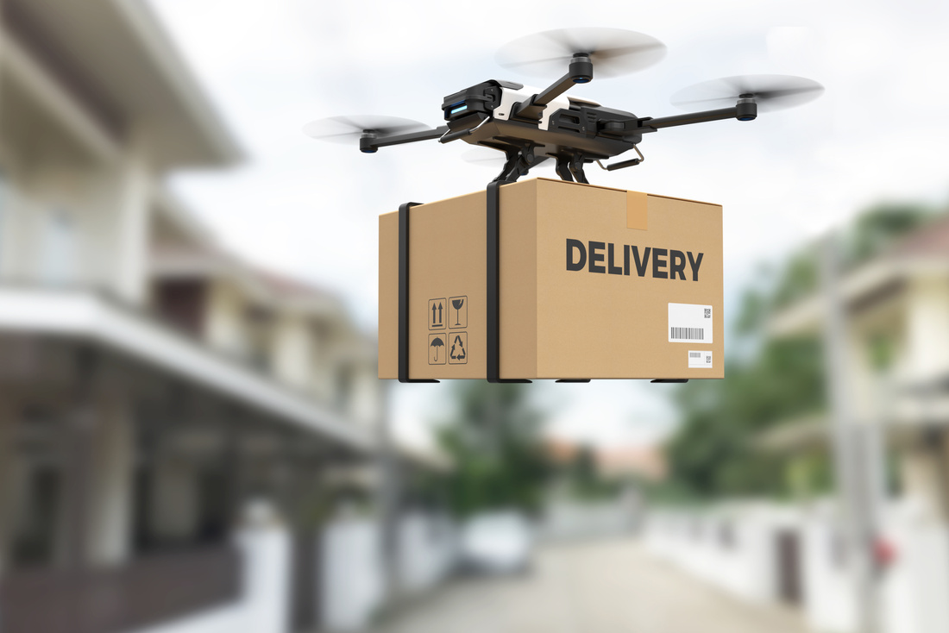
Process
Damage Assessment of Deliverables
Inventory Management
using Machine Learning
Delivering of the Medical Services
Damage assessment involves inspecting delivered packages to ensure their integrity and quality upon arrival.
Inventory management utilizes machine learning algorithms to optimize stock levels and distribution of medical supplies and food items.
Delivering medical services involves transporting essential supplies such as medications, vaccines, blood samples, and medical equipment to remote or inaccessible regions.

Slide 7
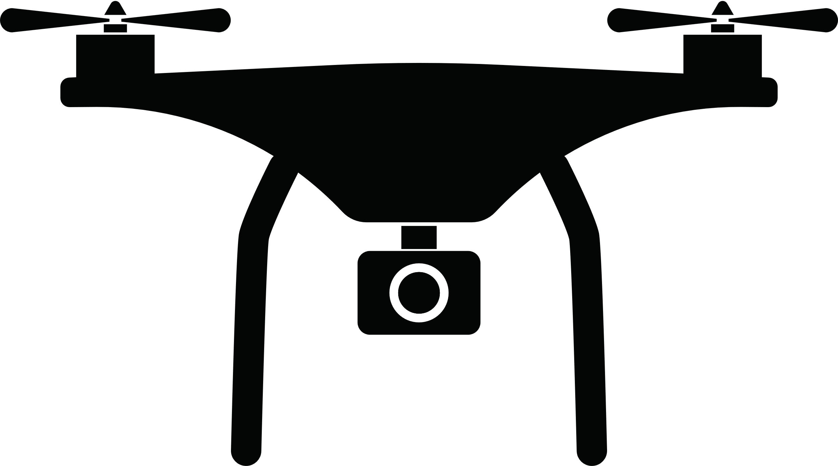
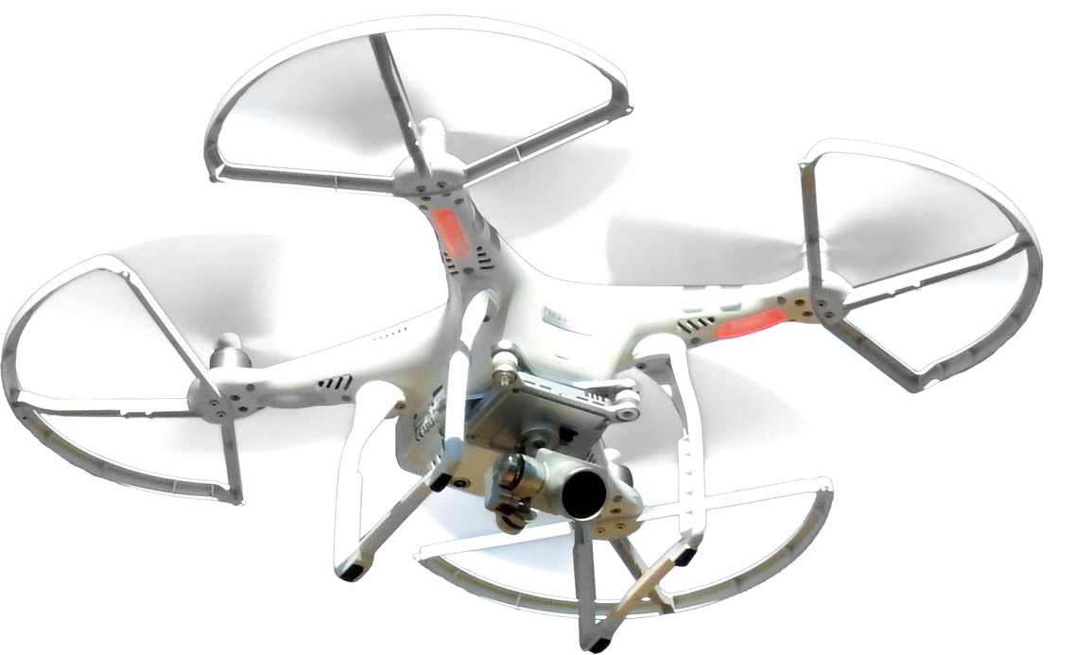

Parameters The Might Affect
Following stated are the parameters that might act as an obstacle to our project
MAX
MAX
RUNNABLE
HEIGHT
SPEED
BATTERY

Slide 8
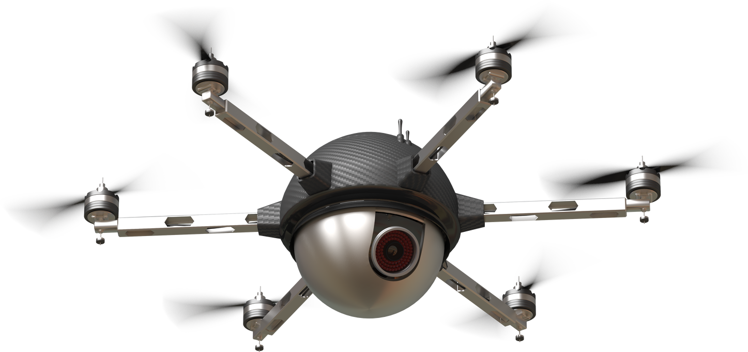
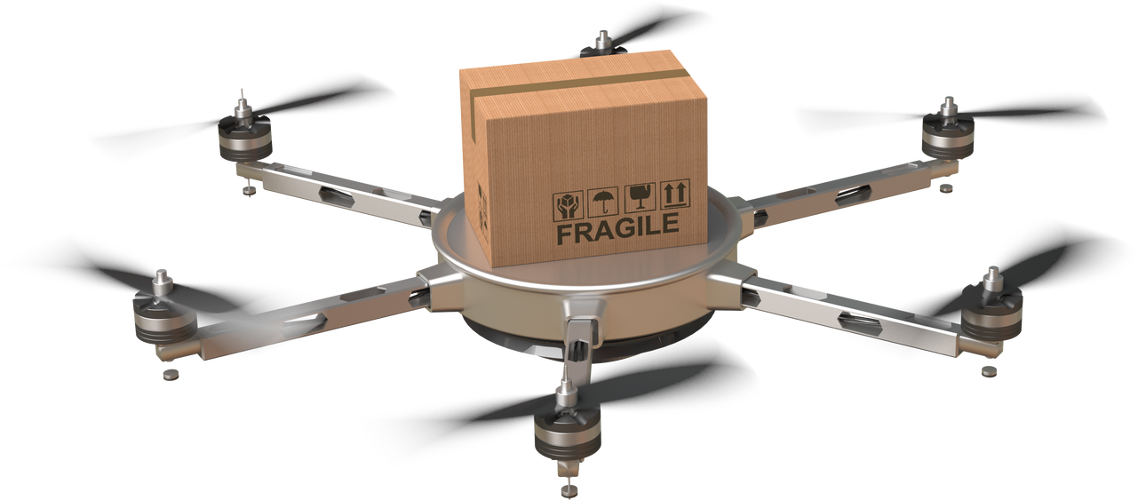
FUNCTIONALITY
What the drone delivery system can help with and will be able to monitor and deliver the medicines and related products to the remote areas.
MONITOR
DELIVERY

Slide 9
Project Stage
Using AGILE Methodology
01
02
03
04
Ideation
Designing
Documentation
Prototyping
Website Development
Portal Development
Implementation of
Machine Learning Algos
and Models to create
self trained models.
Deployment of the Model
Implementation of the project

Slide 10



Project Goals
PRODUCT
SERVICE
METHOD
The products like medical services and material that might be provided by the drone service
Services like Communicating and Broadcasting News can also be attained by this project
The methodology used in this project can be trained and attain accurate model.

Slide 11
Future Goals
AUTOMATIC CONTROL
UNDERSTANDING THE REQUIREMENTS
SELF SERVICING DRONE CALL
The drones will be able to control themselves automatically once the AI model is trained according to the maps and values
Understanding and dropping controls so that the requirements are understood as the drone flies over the affected area.
Self services can be implemented where the drone will itself call another drone which will fulfill the demand of the deliverables.

Slide 12
Thank You!

